Slide 1
Possessive Adjectives
Possession is 9/10 of the law!

Slide 2
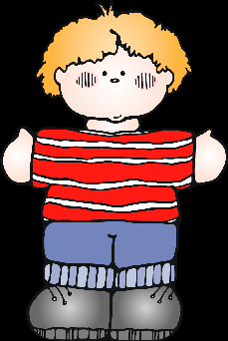
In Spanish there is no apostrophe “s”
(David’s) to show ownership or possession. So, What do we do? I’m so glad you asked!

Slide 3
There are two ways to show ownership in Spanish.

Slide 4
There are two ways to show ownership in Spanish.
Use a “de” construction
Use this formula –
article + noun + de + owner
Examples:
el libro de Maria (lit: the book of Maria)
Los hermanos de Paco (lit: the brothers of Paco)

Slide 5
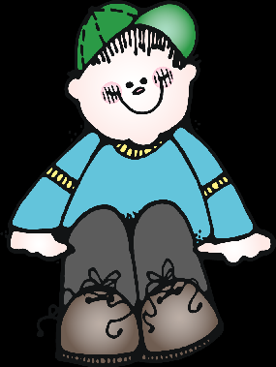
Use possessive adjectives!
Possessive adjectives in English are:
my,
your,
his,
her,
our,
their.
Their Spanish equivalents are as follows.

Slide 6
My = mi(s)
Our = nuestro(s)
Nuestra (s)
Your = tu(s)
XX
His = Su(s) Their = Su(s)
Her = Su(s) Your (pl) = Su(s)
Your = Su(s)

Slide 7
Adjectives must match in number with the object being possessed.

Slide 8
All the possessive adjectives have two forms:
a singular and a plural form.
For example:
My book = mi libro (singular)
My books = Mis libros (plural)
Notice that it matches with the number of nouns not the number of owners.

Slide 9
“Our” has four forms.
It must match in number and gender with the object being possessed.
For example:
our brother = nuestro hermano
our sister = nuestra hermana
our brothers = nuestros hermanos
our sisters = nuestras hermanas

